Slide 1
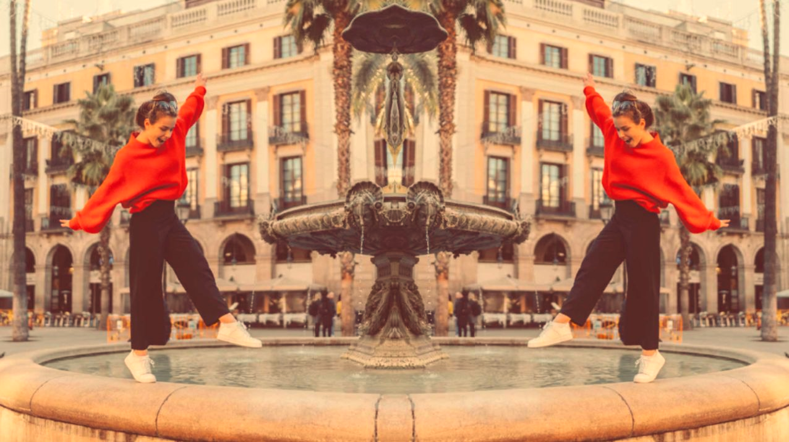


UNIT 6;
Lend me your ear
Lesson 4; Radio

Slide 2
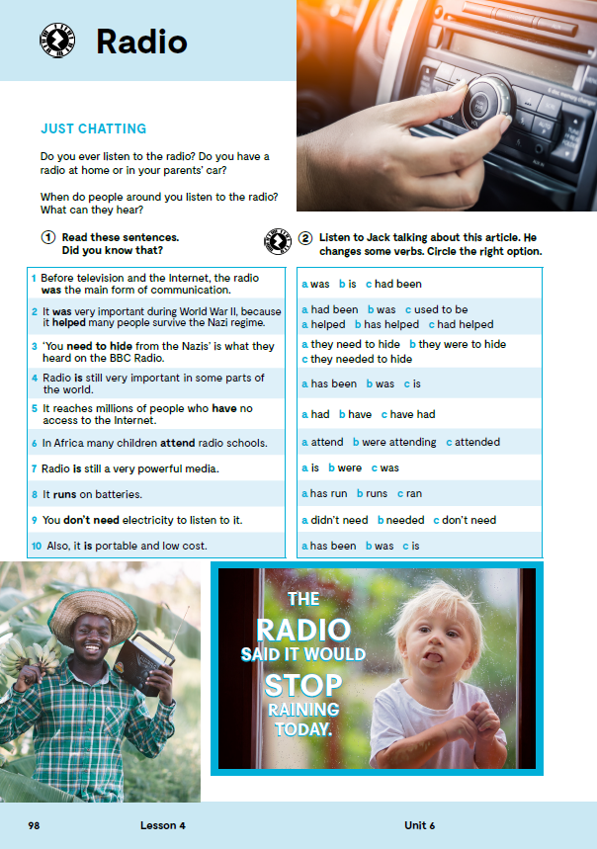
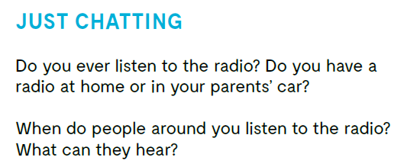

Slide 3

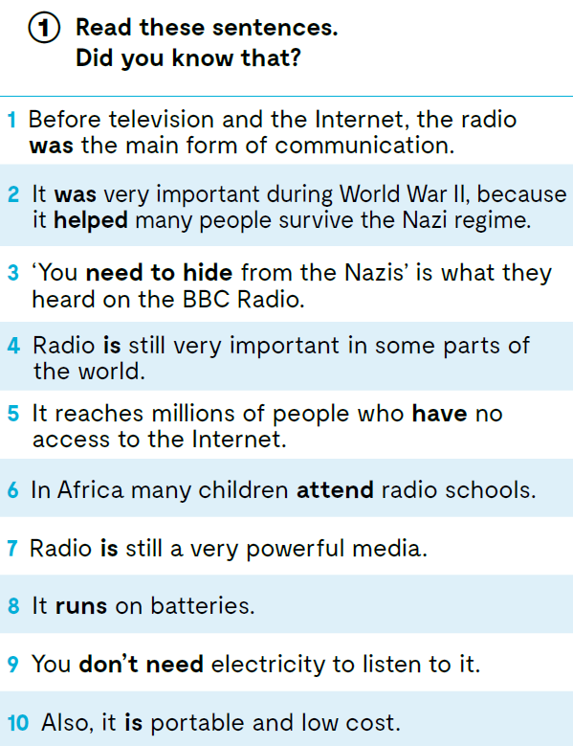

Slide 4
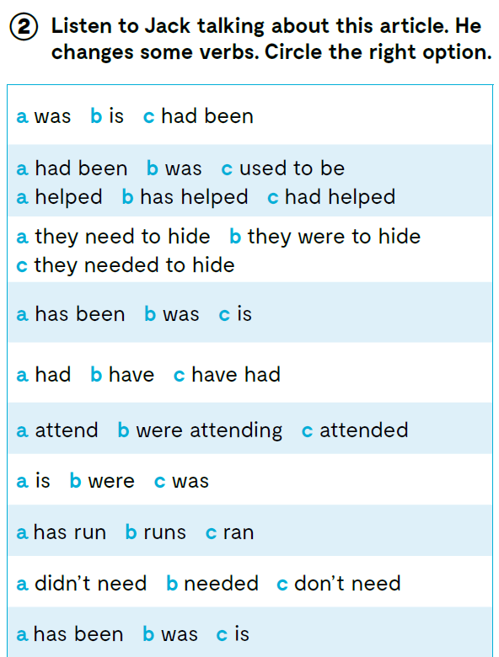

https://www.e-sfera.hr/dodatni-digitalni-sadrzaji/bea9f973-1f8a-4412-a65c-999f72c21a83/assets/audio/24_unit_6__lesson_4__exercise_2.mp3

Slide 5
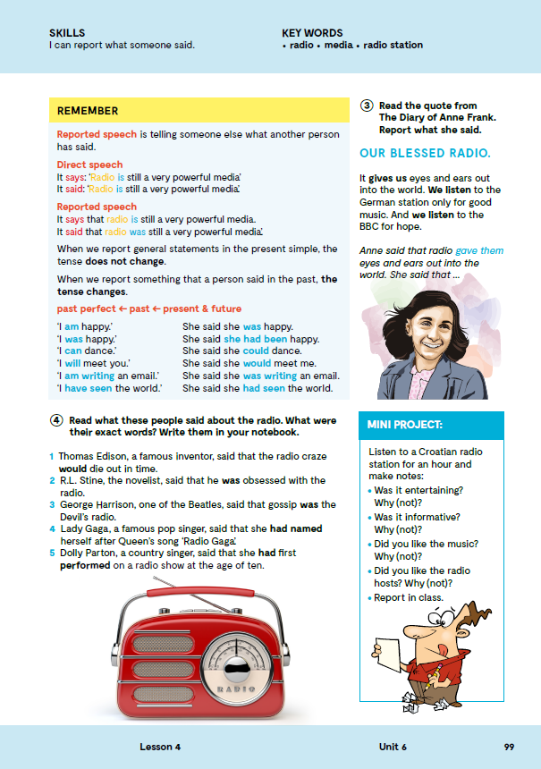
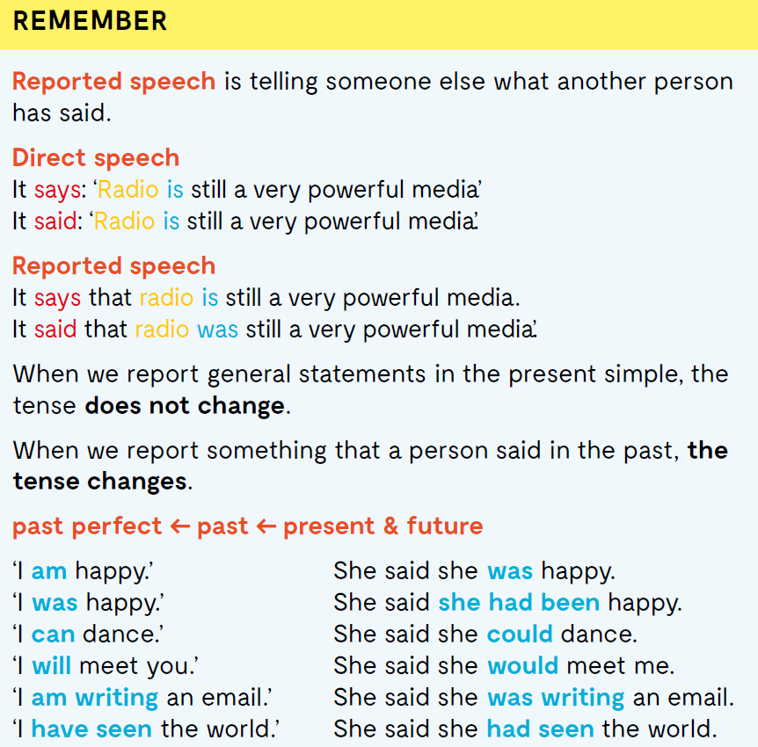
On the next page, page 99.
REPORTED SPEECH tj. neupravni govor koristimo kada sadržaj tuđega govorenja prenosimo trećoj osobi, bez doslovnoga navođenja (citiranja).
Kad se govor prenosi u vremenu present simple, ne dolazi do promjene vremena. Ako prenosimo nešto što je izrečeno u prošlosti, dolazi do promjene vremena koja slijedi pravilo „one tense back“.

Slide 6
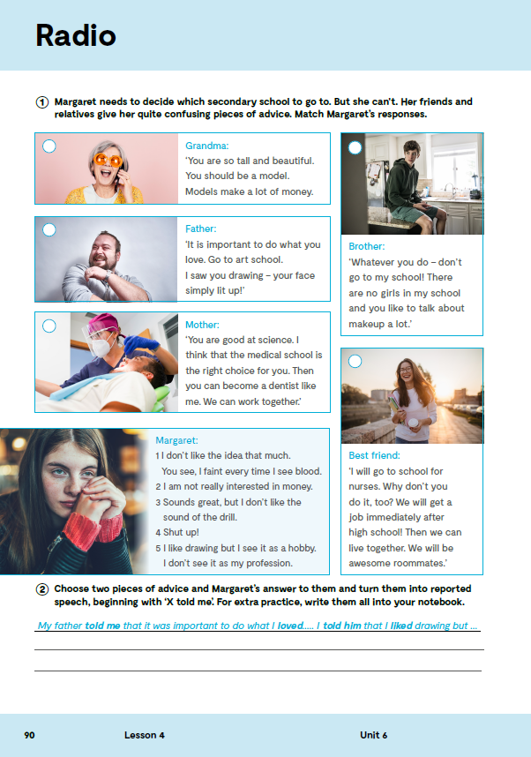
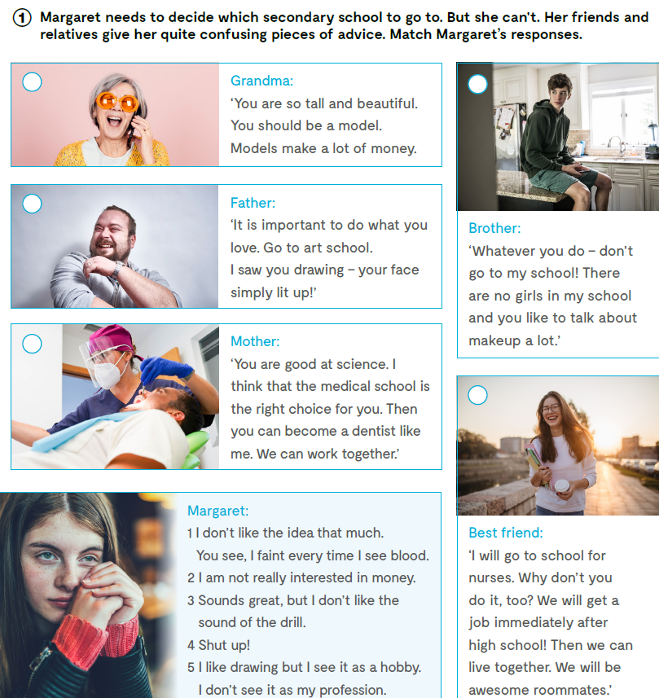

Open your exercise book, page 90.
2
4
5
Open the following link and then click on LEARN MORE!
https://www.e-sfera.hr/dodatni-digitalni-sadrzaji/bea9f973-1f8a-4412-a65c-999f72c21a83/
From smoke to smartphone
Read the texts and
do the tasks bellow the text.
Pročitaj tekstove i riješi zadatke ispod teksta.
3
1

Slide 7

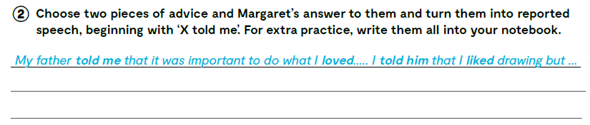

Slide 8

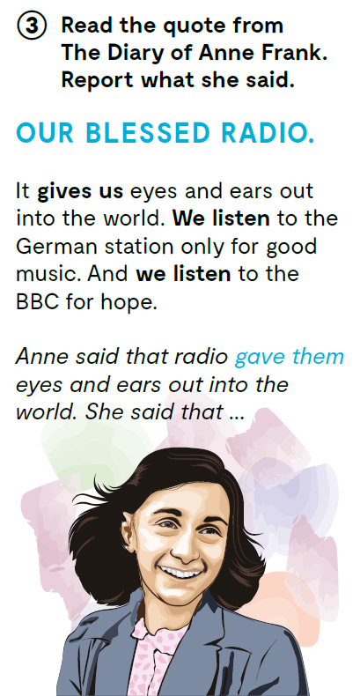
Anna Frank said that radio gave them eyes and ears out into the world.
She said that they only listened to the German station for good music.
She also said that they listened to the BBC for hope.

Slide 9

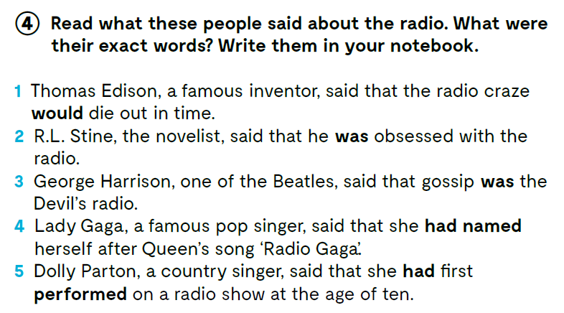

Slide 10
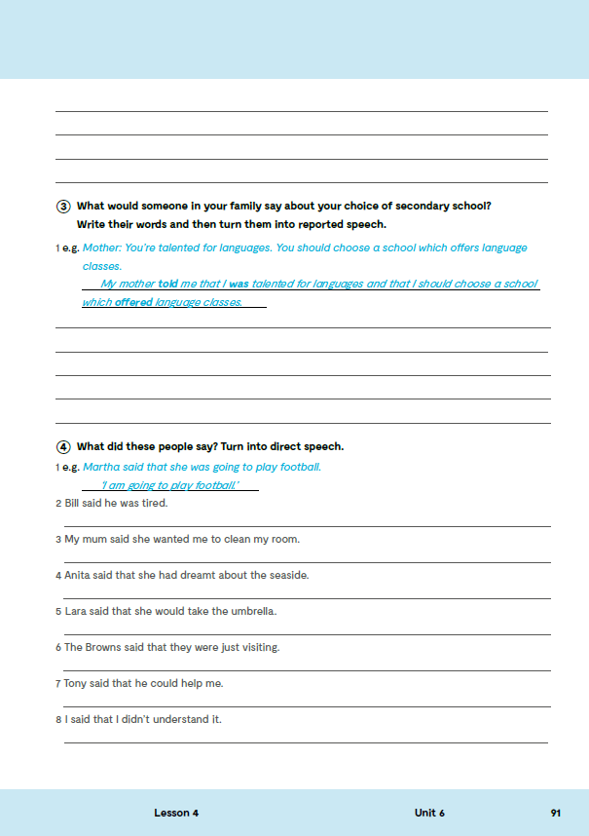
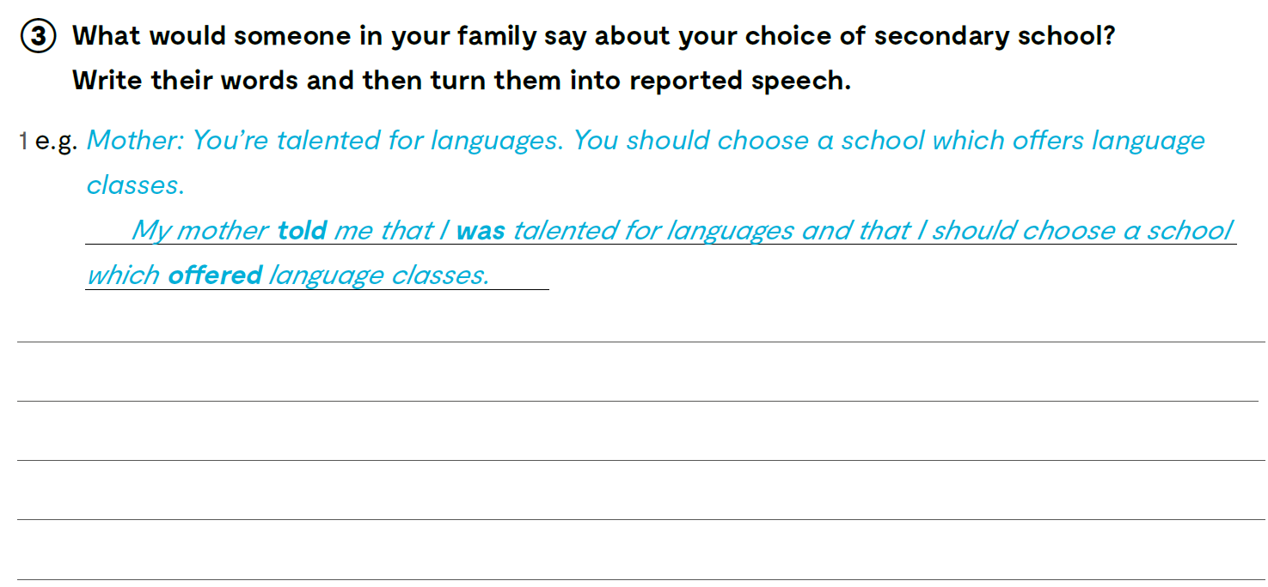
Workbook, page 91.

Slide 11
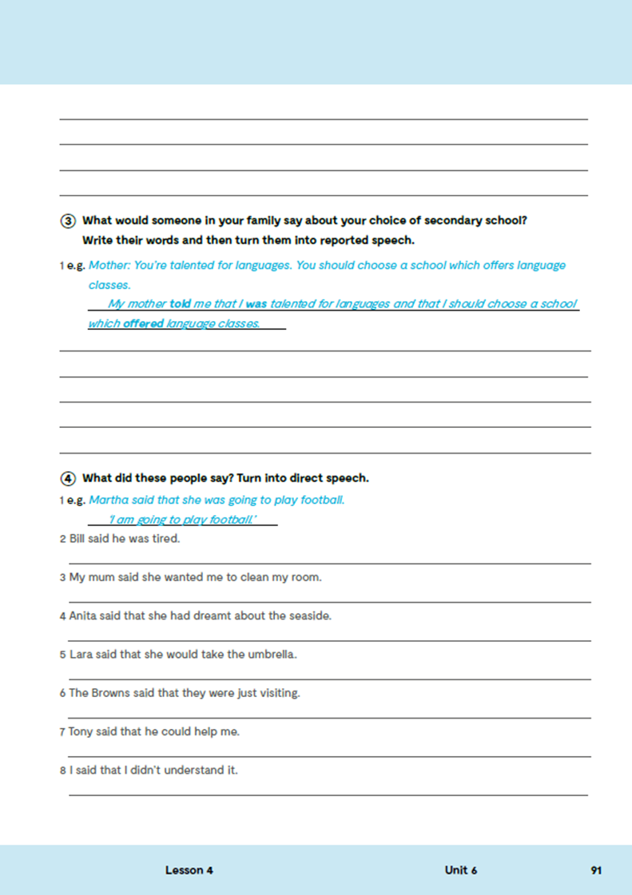
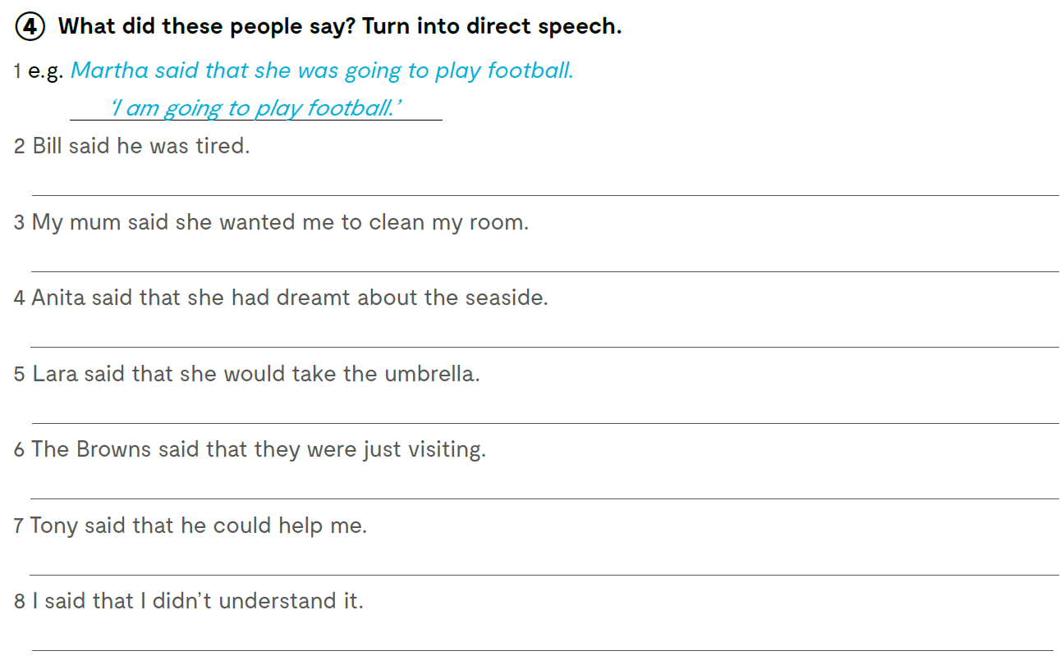
‘I’m tired.’
‘I want you to clean your room.’
‘I have dreamt about the seaside.’
‘I will take the umbrella.’
‘We are just visiting.’
‘I can help you.’
‘I don’t understand it.’
Check what you have learnt. https://learningapps.org/watch?v=p88hn5j7321

Slide 12
Turn these lines from famous movies into reported speech.
1 “Frankly, my dear, I don’t give a damn.” - Gone with the Wind
2 “Ogres are like onions.” – Shrek
3 “I want to play a game.” - Saw
4 “I’m going to make him an offer he can’t refuse.” - The Godfather
5 “I’ve got a feeling we’re not in Kansas anymore.” - The Wizard of Oz
6 “Love means never having to say you’re sorry.” - Love Story
7 “If you build it, he will come.” - Field of Dreams
8 “Mama always said life was like a box of chocolates. You never know what you’re gonna get.” - Forrest Gump
9 “A million dollars isn’t cool. You know what’s cool? A billion dollars.” - The Social Network
10 “I don’t want to survive; I want to live!” - Wall-E
11 “The night is always darkest just before the dawn, but I assure you, the dawn is coming.” - The Dark Knight
12 “All we have to decide is what to do with the time that is given us.” - The Lord of the Rings: The Fellowship of the Ring
13 “I’m the king of the world!” - Titanic
14 “Where we’re going, we don’t need roads.” - Back to the Future

Slide 13
